Slide 1
Community Choice Energy for Alameda County
Status Update
City of Newark
Thursday, April 14, 2016

Slide 2
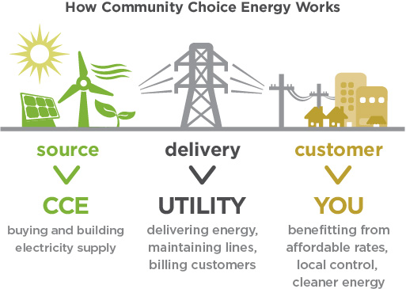
What is Community Choice Energy?
CCE enables local governments to procure and/or develop power on behalf of their public facilities, residents and businesses. It has proven to increase renewable energy and lower greenhouse gases while providing competitive electricity rates.

Slide 3
Potential CCE Advantages
CCE is responsive to local environmental and economic goals
Offers consumers a choice where none currently exists
Revenue supported, not taxpayer subsidized
Stable, often cheaper, electricity rates
Allows for rapid switch to cleaner power supply and significant
GHG reductions; achievement of local CAP goals
Provides a funding source for energy efficiency and other energy programs like energy storage and EV charging stations

Slide 4
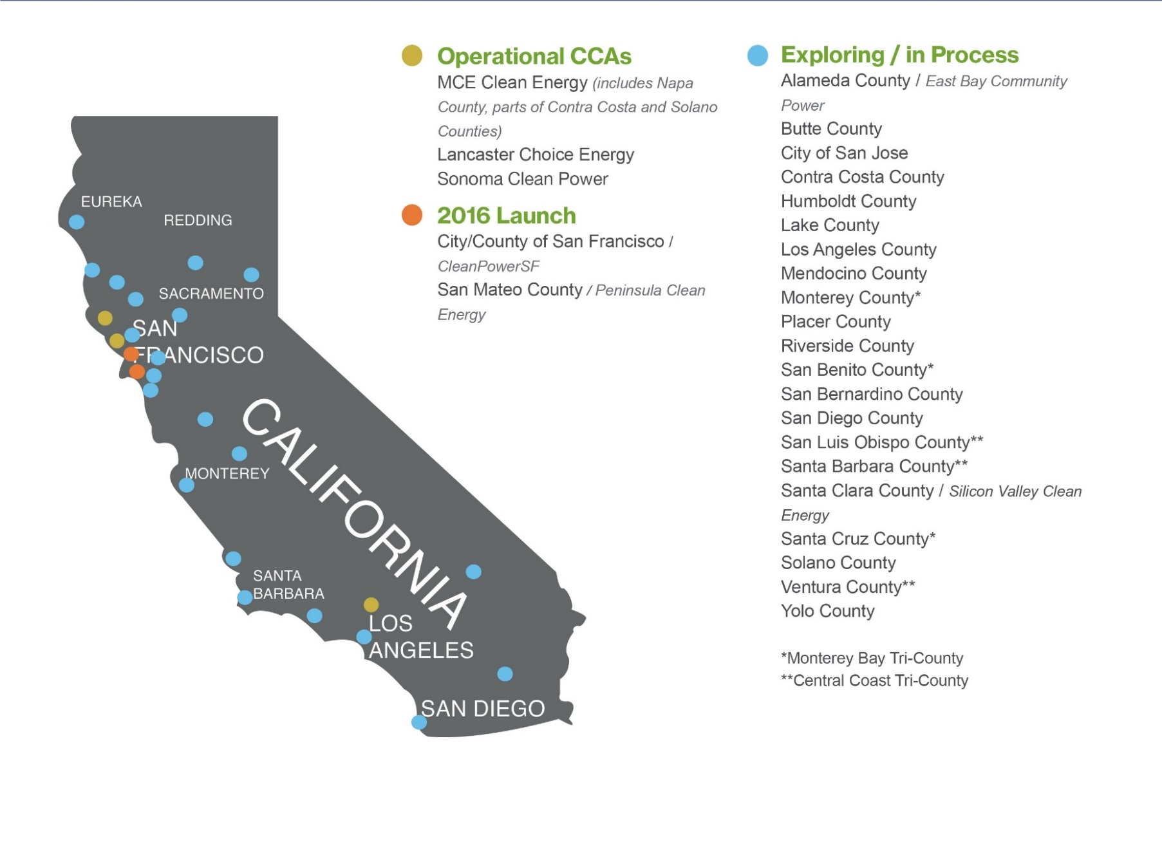
CCE is Growing in California

Slide 5
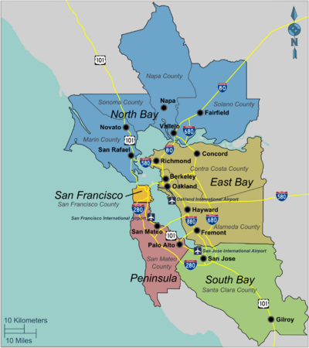
Status in Bay Area Counties
All Nine Counties Engaged …
Operational: Marin, Sonoma Counties
City of San Francisco
Joined Marin: County of Napa
Cities of Richmond,
San Pablo, El Cerrito, Benicia
Launching Soon: San Mateo County
Under Development: Alameda, Santa Clara Counties
Early Investigations: Contra Costa County
Next/Follow Up: Solano County

Slide 6
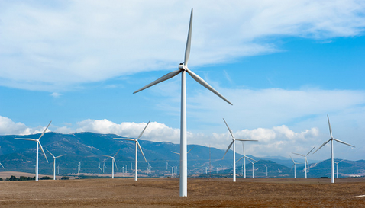
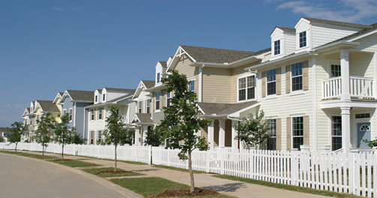
The Context in Alameda
In June 2014, the Board of Supervisors allocated $1.32 million to assess CCE in Alameda. Up to $3.25 million may be spent if the first phase looks positive.
First phase includes establishing the Steering Committee, doing city and stakeholder outreach, and conducting the technical study.
All eligible cities authorized load data collection
MRW & Associates in Oakland was selected as the tech. study consultant and has started work.

Slide 7
3 CCE Programs in California… so far
Launch Year | 2015 Avg. Customer Rate Savings | Power Options (current)
2010 | 2-5% below PG&E | 56% Renewable 100% Renewable 100% Local Solar
2014 | 6-14% below PG&E | 36% Renewable 100% Renewable
2015 | 3-4% below SCE | 35% Renewable 100% Renewable

Slide 8
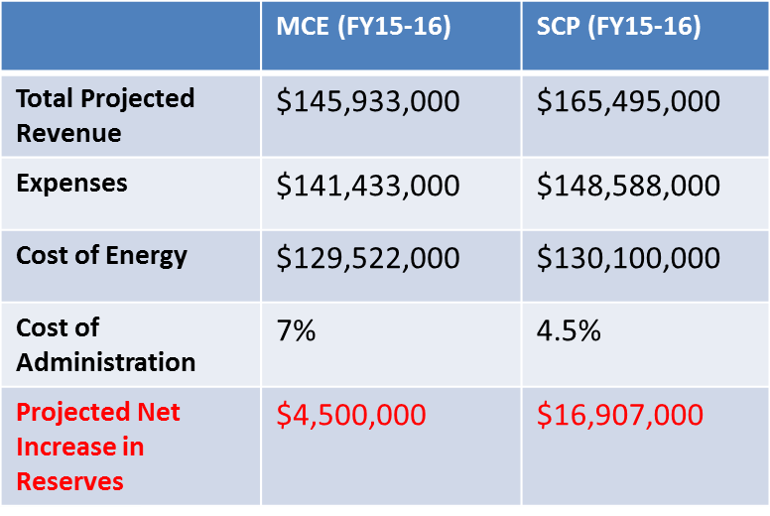
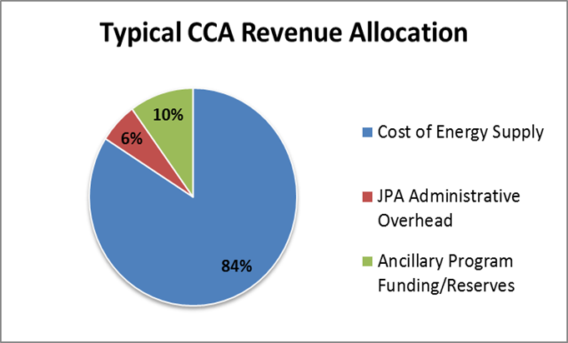
CCE Financial Performance
MCE and SCP are fiscally sound

Slide 9
Basic Program Mechanics
Form or join a Joint Powers Agency: Local governments participate by passing an ordinance and entering into a JPA Agreement. JPA structure protects city general funds.
Utility (PG&E) continues to provide consolidated billing, customer service, grid and line maintenance.
PG&E programs for low income/CARE customers remain the same
CCE electric generation charges (including exit fee) appear as new line items on the customer bill; all other charges remain the same.
5. CPUC certifies CCE Plan; oversees utility/
CCE service agreement and other requirements.
6. Under State law, CCE is an “opt-out” program.

Slide 10
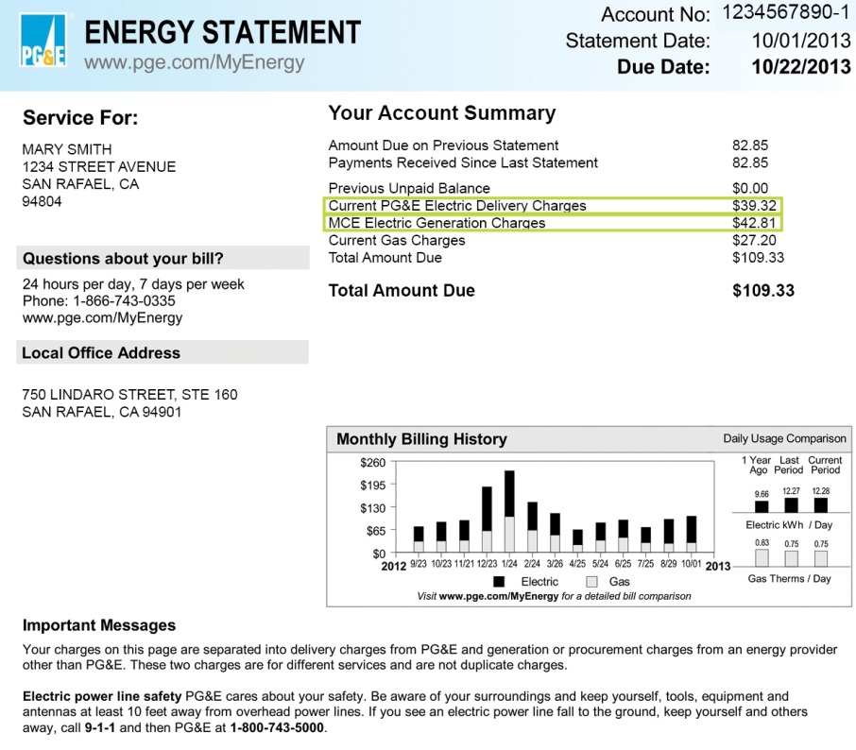
Sample Energy Bill – MCE
Page 1
Page 2

Slide 11
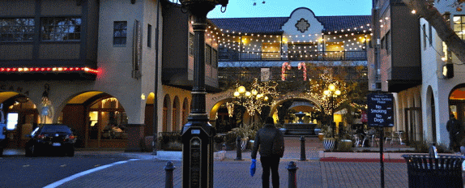
CCE & Local Climate Action Plans Excerpt from City of San Mateo Climate Action Plan
Note that CCE programs do not impose additional costs to property owners/developers
TTons of CO2 reduced through 2020

Slide 12
What are the Risks… And how are they mitigated?
Rate Competition/Market Fluctuation: Rates will vary with market conditions. Power market expertise and well crafted power RFPs are essential; Diversified supply portfolio and “value add” programs.
Customer Opt-Out: Competitive rates are a must; Articulate additional consumer and community benefits.
Political: Align CCA to local policy objectives; Appeal to both progressive and conservative minds by making the environmental AND business case.
Regulatory/Legislative: PUC decisions may adversely affect CCA; also example of AB 2145; Participate in the regulatory and legislative process.

Slide 13
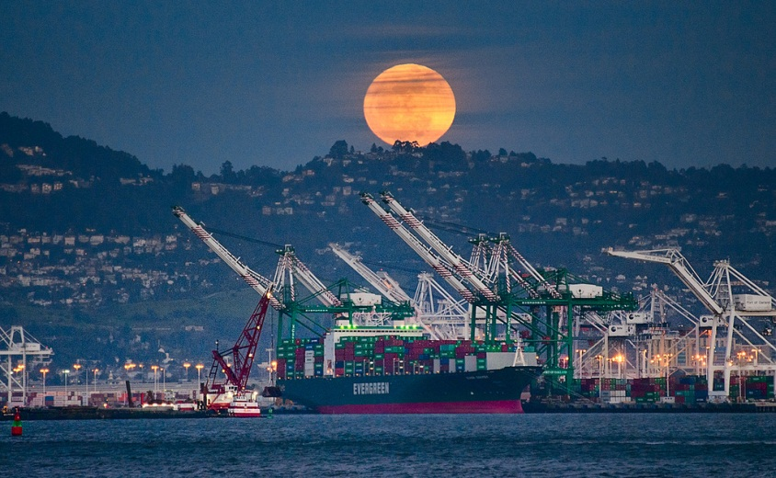
Next Steps: Tech Study
Economic Development: Seeking to quantify more precisely the job creation benefits of local renewables development
Energy Efficiency: Assessing the potential for energy efficiency programs as an integral part of the CCE program
Draft of tech study expected to be completed by late-May.
Purpose is to determine MWH need, peak demand requirements, ability to be competitive with PG&E and procure enough renewables
Alameda’s tech study is unique for two reasons:

Slide 14
Tech Study Results from San Mateo
Key Considerations | Scenario 1 | Scenario 2 | Scenario 3
General Environmental Benefits | 35% Renewable 35% GHG-Free | 50% Renewable 63% GHG-Free | 100% Renewable 100% GHG-Free
Rate Competitiveness (on average, relative to PG&E rate projections) | 6% savings | 4% savings | 2% increase
Projected Residential Customer Cost Impacts (On average, relative to PG&E rate projections. Average monthly usage for residential customers ≈ 450 kWh) | $5.40 monthly cost savings | $4.05 monthly cost savings | $1.80 monthly cost increase
Assumed Customer Participation | 85% across all customer groups | 85% across all customer groups | 75% for residential and small commercial 50% for all other groups
Comparative GHG Emissions Impacts (approx. savings in metric tons of CO2 equivalent) | 211,000 MTCO2 of additional GHG emissions in Year 1 | 75,000 MTCO2 of GHG emissions reduction in Year 1 | 204,000 MTCO2 of GHG emissions reduction in Year 1

Slide 15
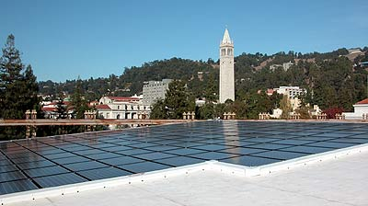
CCE Steering Committee (SC)
Representatives from all cities included
Stakeholders including environmental groups, labor, social justice and other organizations
The SC meets every month to discuss CCE issues and advise Board of Supervisors (for example, the Committee advised on the scope of the technical study).
Also a forum for discussion and education (including presentations on broader energy markets, CCE policy updates, etc.)

Slide 16
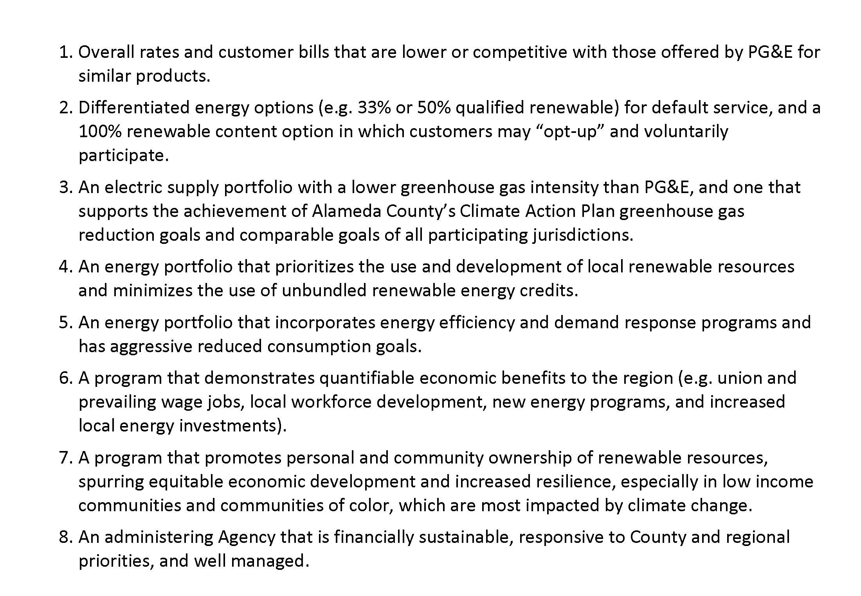
Steering Committee Goals

Slide 17
Project Timeline
Goal is to launch EBCE by April 2017
To meet this goal, we are working on parallel paths
The County is starting the JPA process now and has reached out to all the city managers and attorneys. The tentative deadline to join the JPA is October 31, 2016
As an initial step, County is briefing all the cities on progress to date and plans going forward.

Slide 18
Project Timeline
Phase 1a: Initial
Phase 1b:
Tech Study
Phase 2: Program Dev’t
Phase 3: CCE Launch
BOS funds allocated
Load data request into PG&E
Steering Committee (SC) formed
Webpage and Stakeholder database developed
Final scope reviewed by SC
RFP issued and Study completed
Targeted stakeholder mtgs; plan for Phase 2 community outreach
Expand website
Go/No-Go decision
Enabling Ordinances (CCE/JPA)
Expanded outreach
Energy Svcs RFP/ Negotiations
Implementation Plan to CPUC
Utility Service Agrmt
Bridge financing to revenue
• JPA Org. Devt (e.g. working cap, staffing)
• Data Mgmt and other Svc. Contracts
Marketing campaign
Call Center; opt-out notifications
Conservation & Renewables programming
Q2 2017
Program Launch
June
2016
Q2/3 2016
Q3/4 2016
Go/No-Go Decision
Initial JPA Formation
Imp Plan & Energy Svcs
18

Slide 19
What We’re Asking from the Cities
Your city manager has already authorized collection of your city’s load data for the technical study.
Right now, we’re only updating you and re-introducing the concept to city councils.
If the study seems positive and if the BOS approves funding for Phase 2, we will do another round of presentations to the cities on the study’s results. Most likely in early-summer.
At that point, we will ask cities to decide whether or not they will join EBCE. A copy of the negotiated JPA agreement and CCE ordinance will be provided.
The tentative deadline for cities to determine their participation is October 31.
The County stands ready to assist the cities in whatever it needs to make this decision (community workshops, study sessions, preparation of staff reports, etc.). No expenditure of city general funds will be required

Slide 20
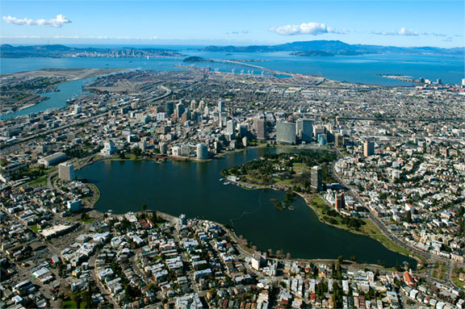
Thank you!
For further information, please contact:
Bruce Jensen
Alameda County Planning Department
(510) 670-5400
Bruce.Jensen@acgov.org

